Slide 1
Task 3a. data base design in Data Warehousing Process
Arun Sen
Department of Information & Operations Mgmt.
Mays Business School
Texas A&M University

Slide 2
Following the Data Warehousing Process
BI Reports using SSRS
ETL
To extract, transform and load the data into Presentation Server)
5. Visualizations
BI Reports using SSAS
Transform (T)
Presentation Server (EDW or Independent Data Marts)
2. Choosing an Architecture
BI Reports with Report Builder, Power BI etc.
Staging Area
Extract (E)
Load (L)
Data Mining
Tables (ER-Relation or Stat/Snowflake)
Source Systems
Data Mining
Data Mining
3. Data Design to create table descriptions
1. Req. Gathering to create Business Questions

Slide 3
Data Design for Data Warehousing
A. Data Design Process used by Data Architect
Business Questions and Requirements documents
Decide on a data modeling technique
Build the logical model
Build the physical model -- schema

Slide 4
Data Design for Data Warehousing
B. Terms to be used in Data Modeling --
Conceptual Model -- world model -- ERD
Logical Model -- model used by a DBMS - RDM
Physical Model – adding physical characteristics like indexing style, etc.
Implementation model -- use of Oracle or SQL Server style

Slide 5
Data Design for Data Warehousing
C. Two Choices in Data Design --
ERD (conceptual) and Relational Schema (logical)
Dimensional model (conceptual+logical) and Star/Snowflake Schema (logical)

Slide 6
I. ERD (conceptual) & Relational Schema (logical) – Targeted for EDW

Slide 7
I. ERD and Relational Schema
Traditional data base design
Step 1: Build the ERD for the enterprise (either directly or through conformable data marts) - - “conceptual model”
Step 2: Translate it to a set of relations using translation rules
Step 3: Evaluate the relations (called a process of Normalization with an objective to have all relations in the “3NF model”
Step 4: Denormalize as needed

Slide 8
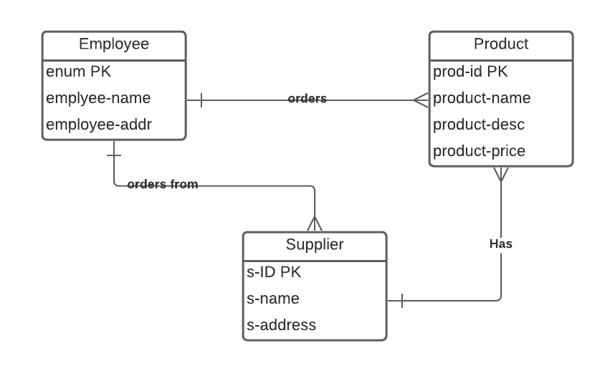
I. ERD and Relational Schema
Step 1
To understand database design, watch this video: https://www.youtube.com/watch?v=I_rxqSJAj6U
For Lucid chart https://lucid.app/lucidchart/6f67e4b8-b2d4-40c5-b61e-a8b426c2f487/edit?beaconFlowId=81B2705DE817D131&page=0_0#?folder_id=home&browser=icon
Download Visio from https://azureforeducation.microsoft.com/devtools

Slide 9
I. ERD and Relational Schema
Step 2. Translated Relations are as follows:
Employee (enum, employee-name, employee-addr)
Supplier (s-ID, s-name, s-address, enum)
Product (prod-id, product-name, product-desc, product-price, enum, s-ID)
Translation Rule 1
[a] Each entity type in an ERD (that is not ”weak”) is transformed to a relation.
[b] The PK of the entity becomes the PK of the relation
[c] The non-key attributes of the entity become the non-key attributes of the relation.
Translation Rule 4
For each binary relationship WITH attributes, generate a new relation. The key of this relation is the “composite key” consisting of primary key for each of the entities in the relationship.
Translation Rule 5
For each binary relationship WITHOUT attributes, generate a new relation only if the relationship is (many, many). The key of this relation is the composite key consisting of primary key for each of the two entities in the relationship.
Translation Rule 2
[a]For each weak entity type generate a new relation.
[b] The PK is the composite key created by concatenation of its own key and primary key of the supporting entity.
[c] The non-key attributes of the entity become the non-key attributes of the relation.
Step 2
Translation Rule 6
For each binary relationship WITHOUT attributes, if the relationship is (1,many) or (1,1), place a foreign key in the relation that represents the entity on the many-side of the relationship. The foreign key is the primary-key of the entity on one-side of the relationship. For (1,1), the foreign key can be placed in either relation.
Translation Rule 3
For each n-ary relationship, generate a corresponding relation. The key is the “composite key” consisting of primary key for each of the entities in the relationship.

Slide 10
I. ERD and Relational Schema
Step 3
First normal form (1NF) is a property of a relation in a relational database. A relation is in first normal form if and only if the domain of each attribute contains only atomic (indivisible) values, and the value of each attribute contains only a single value from that domain.
A relation is in the second normal (2NF) form if it fulfills the following two requirements:
It is in first normal form.
It does not have any non-prime attribute that is functionally dependent on any proper subset of any candidate key of the relation. A non-prime attribute of a relation is an attribute that is not a part of any candidate key of the relation.
A database relation is said to meet third normal form (3NF) standards if all the attributes (e.g. database columns) are functionally dependent on solely the primary key. Codd defined this as a relation in second normal form where all non-prime attributes depend only on the candidate keys and do not have a transitive dependency on another key.

Slide 11
I. ERD and Relational Schema
Step 3
https://www.geeksforgeeks.org/normal-forms-in-dbms/ to understand normal forms
Based up on Normal form definitions, we evaluate the relations with an objective to create Third Normal From relations as follows:
Employee (enum, employee-name, employee-addr) -- 3rd Normal Form
Supplier (s-ID, s-name, s-address) - - 3rd Normal form
Order (s-ID, enum) -- 3rd Normal Form
Product (prod-id, product-name, product-desc, product-price) -- 3rd Normal Form
Supply (prod-id, enum, s-ID) -- 3rd Normal Form

Slide 12
Denormalization of 3NF Relations
Advantages:
-- improve performance
Disadvantages
-- reduces data flexibility
-- introduces the potential for data anomalies
-- increases programming cost and complexity

Slide 13
Denormalization of 3NF Relations
A. Recreating Repeating Column Groups
Why?
A report is needed to compare and calculate percentages of an employee's sales for the last six months.
How is it done now?
Have a 3NF Relation called Employee_Sales_Report (emp#, sales-date, sales-amount).
This is a history table that tends to grow very big over time.

Slide 14
Denormalization of 3NF Relations
Recreating Repeating Column Groups
Choice 1: Denormalize inside the Logical Model
Providing repeating groups with a meaningful name such January, February, etc. ... but SQL statement must be changed each time
Use of non-meaningful column names such as Month-1, Month-2, etc. ... leads to confusion as someone may not know what Month-1 means.
No matter how many columns we provide, there will be more needed ...
Bad Choice

Slide 15
Denormalization of 3NF Relations
A. Recreating Repeating Column Groups
Choice 2:
Keep original in 3NF and add an additional temporary table created and refreshed every month.
Denormalization is outside the logical model ...
cost and complexity
Good Choice

Slide 16
Denormalization of 3NF Relations
B. Derived Data
Derived data is defined as redundant stored data whose values can be determined or calculated from other column values.
Example
Employee(emp#, lastname, store#)
Store (store#, storename)
Choice
We need to find employee count. We can find it by doing a total table scan (expensive!) of Employee table. Instead, we can have:
Store(store#, storename, employee-count)

Slide 17
Denormalization of 3NF Relations
C. Pre-Joins
Some DBMSs like Teradata RDBMS is capable of performing 64-table joins. But this is costly ...
Try to avoid joins to minor relations by carrying their attributes in the major relations.
Example:
Employee(emp#, lastname, store#) needs to be joined with Store(store#, storename)
Example:
Instead ...
Employee(emp#, lastname, store#, storename)
Make sure to update properly. Also, keep the Store Relation to avoid anomalies.

Slide 18
II. Dimensional model (conceptual+logical) and Star/Snowflake Schema (logical) – Targeted for Independent Data marts

Slide 19
Following the Data Warehousing Process
BI Reports using SSRS
ETL
To extract, transform and load the data into Presentation Server)
5. Visualizations
BI Reports using SSAS
Transform (T)
Presentation Server (EDW or Independent Data Marts)
2. Choosing an Architecture
BI Reports with Report Builder, Power BI etc.
Staging Area
Extract (E)
Load (L)
Data Mining
Tables (ER-Relation or Star/Snowflake)
Source Systems
Data Mining
Data Mining
3. Data Design to create table descriptions
1. Req. Gathering to create Business Questions

Slide 20
II. Dimensional Modeling and Star/Snowflake Schema
1. History of Dimensional Modeling
first used by General Mills and Dartmouth University in 1960’s
in 1970’s it is used by Nielson Marketing
in 1984 -- Kimball introduced it as a data modeling tool for conformable Data marts

Slide 21
II. Dimensional Modeling and Star/Snowflake Schema
2. What is Dimensional Modeling?
It is a logical design technique that seeks to present data in a standard format that is intuitive and allows for high-performance access
Fundamental idea of dimensional modeling is that every type of business data can be represented as a Cube or Hypercube.
More suitable for Kimball’s strategy
Not much use in creating an enterprise-wise star schema!!

Slide 22
Star Schema
Time Dimension
Sales Fact Table
Time-key (PK)
Day-of-week
week-number
Month
Time-key (FK)
Product-key (FK)
Store-key (FK)
dollars-sold
units-sold
dollars-cost
Product Dim
Product-key (PK)
SKU
description
brand
category
Store Dimension
Store-key (PK)
store-ID
store-name
address

Slide 23
II. Dimensional Modeling and Star/Snowflake Schema
3. Components of Dimensional Model
It consists of two types of tables --
Fact table with attributes
Dimension table with attributes

Slide 24
II. Dimensional Modeling and Star/Snowflake Schema
4. What is a Fact Table?
It contains the observations of the market place
Facts should be
Additive (e.g., sales data)
Non-additive (some facts could be non-additive such as account balance over time)
Semi-additive (some account balance could be additive along other dimensions)
Textual (keep them at minimum)

Slide 25
II. Dimensional Modeling and Star/Snowflake Schema
4. What is a Fact Table?
It is usually the m:n relationship of the ERD
contains lot of FKs

Slide 26
II. Dimensional Modeling and Star/Snowflake Schema
4. What is a Fact Table?
Characteristics of a fact table
it will contain concatenated key
data granularity is important for a fact table.
fully additive measures
semi-additive measures
table is deep and not wide (i.e., not too many attributes)
sparse data
Degenerate dimension
Sometimes when we start to collect attributes from OLTP systems for dimension tables and fact tables, we may left out with attributes like Order# or Order-line#. These are neither facts nor strictly dimension attributes. Usually, we put them in the fact table are called “degenerate dimensions.” They are needed to relate orders to products

Slide 27
II. Dimensional Modeling and Star/Snowflake Schema
5. Types of Fact Table?
Different types of Fact Tables –
Single fact table
Multiple fact tables

Slide 28
II. Dimensional Modeling and Star/Snowflake Schema
6. Single Fact Table
Sales Fact Table
Time-key (FK)
Product-key (FK)
Store-key (FK)
dollars-sold
units-sold
dollars-cost

Slide 29
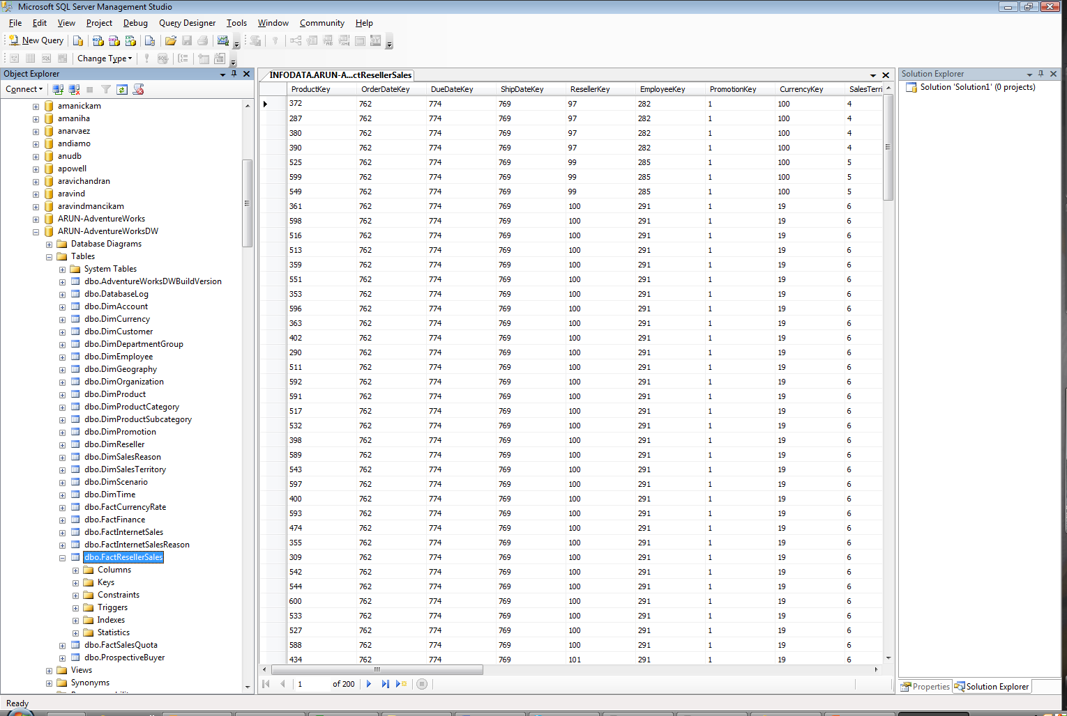
II. Dimensional Modeling and Star/Snowflake Schema
6. Single Fact Table
Look at AdventureWorks DW database

Slide 30
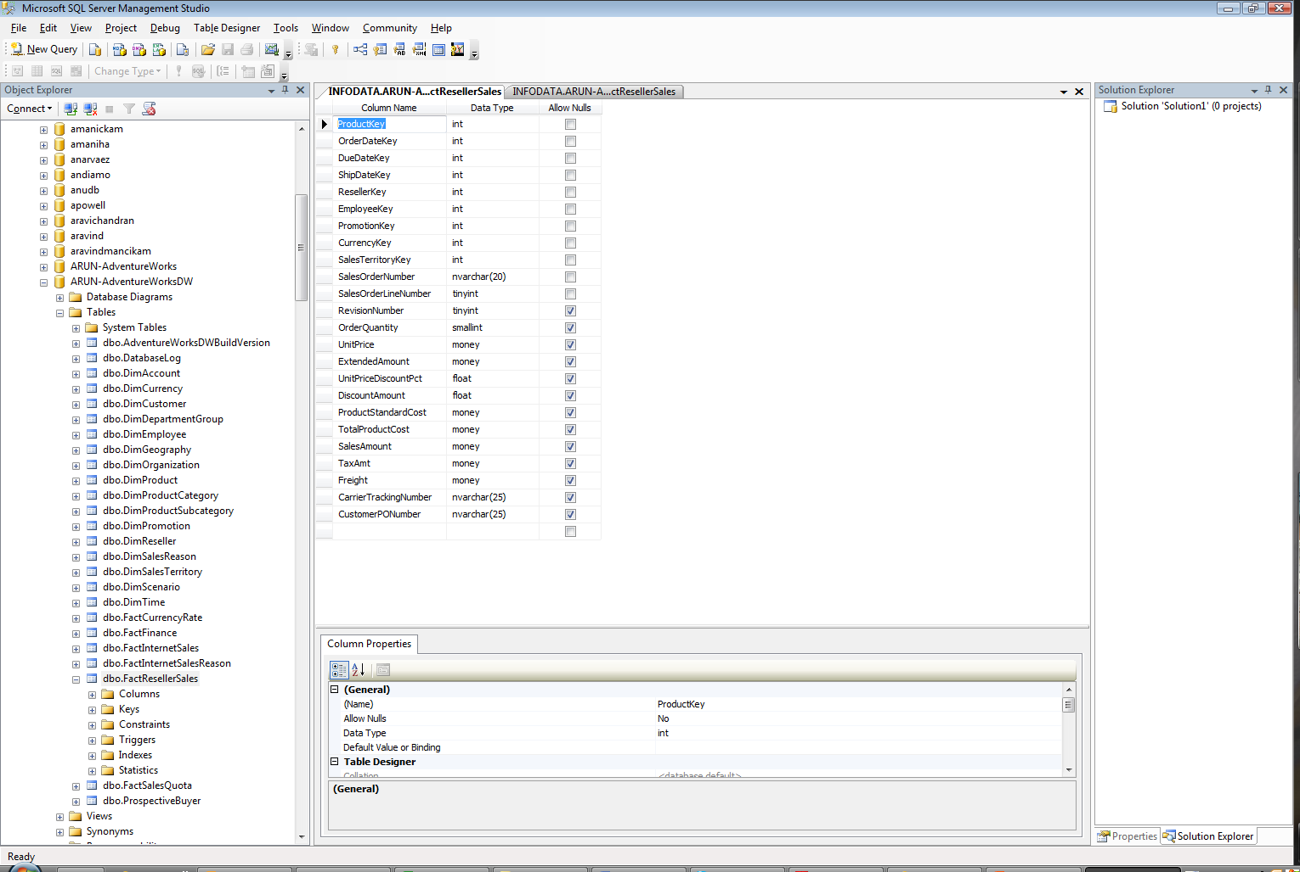
II. Dimensional Modeling and Star/Snowflake Schema
6. Single Fact Table

Slide 31
II. Dimensional Modeling and Star/Snowflake Schema
6. Single Fact Table
Factless Fact Table
• A fact table can be factless if it records an event e.g., student attendance event
• A fact table is factless if it records coverage. For example, if a fact table is used to store the promotion coverage only, it cannot have product data for those that did not sell in spite of promotions.
Date_Key
Course_Key
Professor_Key
Room_Key
Student_Key
Student attendance Fact Table
Time_Key
Product_Key
Store_Key
Promo_Key

Slide 32
II. Dimensional Modeling and Star/Snowflake Schema
7. Why Need Multiple Fact Tables?
Multiple fact tables are needed in several scenarios like:
value chain
value circle
heterogeneous product schemas
Transaction and snapshot schemas
Aggregates

Slide 33
II. Dimensional Modeling and Star/Snowflake Schema
7. Why Need Multiple Fact Tables?
• Case of Value chain
Multiple fact tables are needed to support a business with many processes. Each process creates one or more fact tables. When these processes are arranged in order, they are called Value Chain.

Slide 34
II. Dimensional Modeling and Star/Snowflake Schema
7. Why Need Multiple Fact Tables?
• For a Value chain
In Manufacturing business, a product travels through various steps, starting off as raw materials and ending as finished goods in the warehouse inventory. Steps include addition of ingredients, assembly of materials, process control, packaging etc.
From finished goods inventory, a product moves into shipment to distributor, distributor inventory, distributor shipment, retail inventory, …
At each step, value is added to the product. This workflow forms value chain or supply chain.
Other Examples are Insurance, Order Processing, and others.

Slide 35
II. Dimensional Modeling and Star/Snowflake Schema
7. Why Need Multiple Fact Tables?
• A Typical Value chain
If you are in one of these businesses, you need to track important metrics at different steps along the value chain.
WAREHS
Finished goods Inventory
fact table
Manufacturing Shipments to Distr. Center fact table
Distribution Center Inventory fact table
DC Depletions to Retail Stores fact table
Retail Store Inventory fact table
Value chain →
DC
TIME
SKU
Retail Stores Sale fact table
CONTRACT

Slide 36
II. Dimensional Modeling and Star/Snowflake Schema
7. Why Need Multiple Fact Tables?
For a Value circle
• The businesses can be organized in a value circle so that they are performing or measuring the same kind of transaction. Examples are hospitals, clinics, physician offices, etc. for patient treatments.
TIME dimension
Hospital fact table
pharmacies
DIAGNOSIS
PATIENT
Clinics fact table
GENERATING “PATIENT TREATMENT” OR MEASURING IT
laboratories
PAYER
PROVIDER
medicare
TREATMENT
LOCATION
insurance

Slide 37
II. Dimensional Modeling and Star/Snowflake Schema
7. Why Need Multiple Fact Tables?
For a Heterogeneous product schema
There are many business that apparently “produce” things that are quite dissimilar. For example, a bank may have different lines of businesses, some of which are similar and others are dissimilar. The “savings a/c” and “checking a/c” are similar businesses while they are different from “credit card ops.” These are called “heterogeneous products.” How do you track these dissimilar services or products?
We use CORE FACT TABLE and CUSTOM FACT TABLE.

Slide 38
II. Dimensional Modeling and Star/Snowflake Schema
7. Why Need Multiple Fact Tables?
Core fact table
Core Account dimension
time-key
account-key
branch-key
Household-key
:
fees earned
Num_transactions
Primary balance
Time dimension
Household dimension
Branch dimension
Bank Example: Global View of all accounts

Slide 39
II. Dimensional Modeling and Star/Snowflake Schema
7. Why Need Multiple Fact Tables?
Time dimension
Fact table restricted to all checking accounts
time-key
account-key
:
fees earned
custom fact join key
Custom Checking fact table
custom fact join key
num-overdrafts
:
num-deposits
total-deposits
Bank Example: Line of Business View

Slide 40
II. Dimensional Modeling and Star/Snowflake Schema
7. Why Need Multiple Fact Tables?
• Transaction and Snapshot Schema Case
ATM Transaction
Fact Table
Time_key (FK)
Account_key (FK)
Transaction_key (FK)
Location_key (FK)
account-_num
Transaction_ref
amount
Time Dim
Account Dim
Models raw ATM transactions
Location Dim
Transaction Dim
Audit Dim
Models periodic snapshots obtained from ATM transactions
ATM Snapshot
Fact Table
Time_key (FK)
Account_key (FK)
Status_key (FK)
Earned_revenue
Transaction_count
Ending_balance, ETC.
Account Dim
Time Dim
Audit Dim
Status Dim

Slide 41
II. Dimensional Modeling and Star/Snowflake Schema
7. Why Need Multiple Fact Tables?
Notion of Aggregates
Aggregates are stored summaries built primarily to improve query performance.
The creation of aggregates introduces a family of fact tables that are usually derived from the most granular fact table in each data mart.
Each member of the family represents a particular degree of summarization alone one or more of the fact table’s dimensions.
A mature and full set of aggregates could involve a dozen separate aggregate fact tables, all echoing the original structure of the base fact table.

Slide 42
II. Dimensional Modeling and Star/Snowflake Schema
8. What is a Dimension Table?
Contains descriptive and textual information
Attributes of Dimension Table are the source of most of constraints in the SQL Queries
Examples of dimension are:
a. product dimension
b. store dimension
c. customer dimension
d. time dimension
e. customer address - (commercial customers usually have hierarchies -- location to region)

Slide 43
II. Dimensional Modeling and Star/Snowflake Schema
8. What is a Dimension Table?
Time Dimension
Product Dim
Time-key (PK)
Day-of-week
week-number
Month
Product-key (PK)
SKU
description
brand
category
Store Dimension
Store-key (PK)
store-ID
store-name
City
State
Region

Slide 44
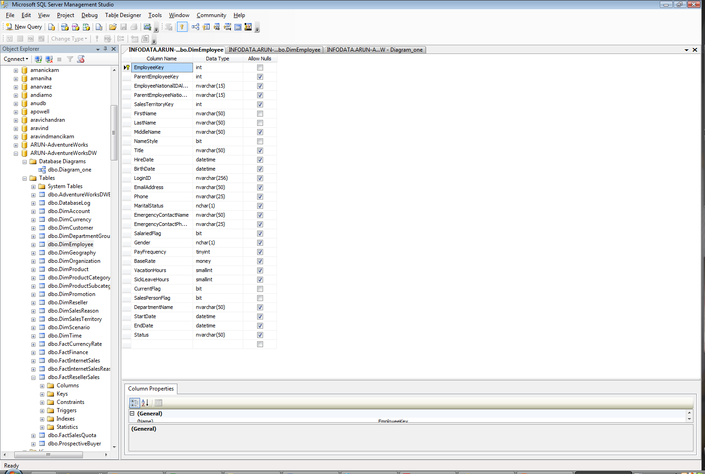
II. Dimensional Modeling and Star/Snowflake Schema
8. What is a Dimension Table?
See AdventureWorks DW database

Slide 45
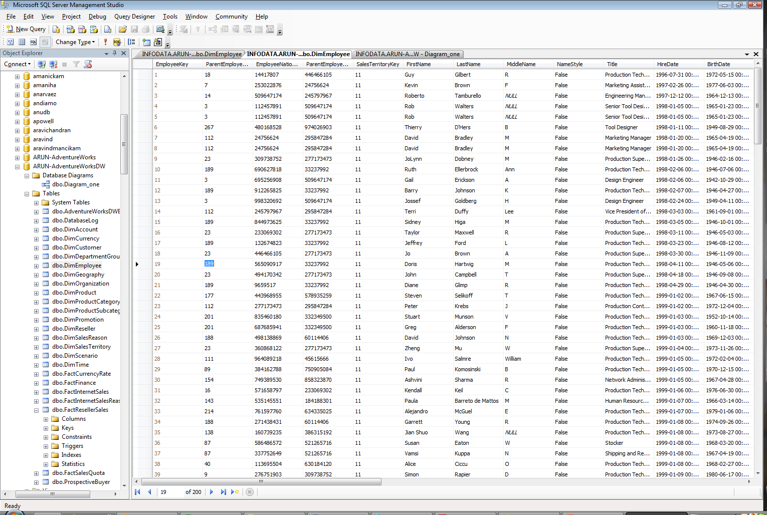
II. Dimensional Modeling and Star/Snowflake Schema
8. What is a Dimension Table?
See AdventureWorks DW database

Slide 46
II. Dimensional Modeling and Star/Snowflake Schema
8. What is a Dimension Table?
Dimensions can be lumped to create more meaningful dimension such as
<product, store> -- in case products are branded to sell in certain stores and also used for browsing
Drilling Up and Down
Each dimension can have hierarchies (which could be more than one; also will talk about implementing this in SSAS) and browsers can be used to see the number of distinct values and to enumerate distinct relationships
"Drill down" means adding more details
"Drill up" means summarization or aggregation
.

Slide 47
II. Dimensional Modeling and Star/Snowflake Schema
9. Types of Dimension Table
Slowly Changing Dimension
even if product key or production-customer key do not change the description of the product or customer does. To handle this problem, three options are available
Type 1 Response: Overwrite the dimension record with the new values. This is used when old description is not useful any more.

Slide 48
II. Dimensional Modeling and Star/Snowflake Schema
9. Types of Dimension Table
Slowly Changing Dimension
Type 2 Response: Create effective date attributes in the dimension table. This is used when a true physical change has taken place and it is appropriate to perfectly partition history by different descriptions. That is “Adding one row per change.”
Type 3 Response: We do not have a change that perfectly partitions history. We create an "old" field in the dimension record to store the immediate previous attribute value. This is used when the sales district has occurred and the change is "soft."

Slide 49
II. Dimensional Modeling and Star/Snowflake Schema
9. Types of Dimension Table
Rapidly Changing Small Dimension
Rate structures continuously change in telecom industry
Use Type 2 of the above

Slide 50
II. Dimensional Modeling and Star/Snowflake Schema
9. Types of Dimension Table
Large Dimensions
With large granularity in data, we may end up with dimensions that are very large.
Examples: product dimension can contain "million" records; insurance companies can have "human" dimension that is very large along with "house" and "automobile" dimensions.
Although current RDBMS can handle such large tables, some conservative design approaches must be chosen.

Slide 51
II. Dimensional Modeling and Star/Snowflake Schema
9. Types of Dimension Table
Rapidly Changing Monster Dimension
Large Dimension has a tendency to change more likely than medium-sized one. For example, customer dimension can change more rapidly than the product dimension. This is because retailers may want to update customer data, etc. OR huge customer dimension with continuously revised demographics
Solution is:
Break the dimension table (customer) into two tables (like customer and demographics)

Slide 52
II. Dimensional Modeling and Star/Snowflake Schema
9. Types of Dimension Table
Rapidly Changing Monster Dimension
Customer Dim
customer-key (PK)
name
original-address
date-of-birth
Customer Dim
customer-key (PK)
name
original-address
date-of-birth
…
income
education
number-children
Demographics Dim
demog-key (PK)
income-band
education-level
number-children

Slide 53
II. Dimensional Modeling and Star/Snowflake Schema
9. Types of Dimension Table
However, there are some compromises:
attributes such as income, etc. must be converted to income_band
build demographics dimension with all possible discrete attribute combinations

Slide 54
II. Dimensional Modeling and Star/Snowflake Schema
9. Types of Dimension Table
Junk dimension
Sometimes you are left with flags and text attributes. These flags and text attributes do not organize in any coherent way. Often the meaning of these is quite obscure.
It is a bad idea
Choices:
Discard them – Not a good option as removing them may create problems for the business.
Leaving them in the fact table and they will swell the definition of fact table
Making each separate flag and attribute into its own dimension will increase the number of dimension!!

Slide 55
II. Dimensional Modeling and Star/Snowflake Schema
9. Types of Dimension Table
Junk dimension
Best will be ---
Create a dimension called Junk Dimension that is a convenient grouping of random flags and attributes to get them out of a fact table and into a useful dimensional framework.

Slide 56
II. Dimensional Modeling and Star/Snowflake Schema
10. Different Keys used in Dimensional Modeling
Foreign Keys (mostly reside in fact tables; can appear in dimension table also in snowflake schema)
Primary Keys (same notion as we know; appears mostly in dimension tables)
Surrogate Keys (These are DW Keys and are meaningless. They are used to connect dimension tables with the fact table. Usually, it is a 4-byte integer. Also applicable to Dates.)

Slide 57
II. Dimensional Modeling and Star/Snowflake Schema
10. Different Keys used in Dimensional Modeling
Avoid Smart Keys (Avoid the temptation of making overloaded keys.)
Do not use production keys (These are the PKs in the production process.)

Slide 58
II. Dimensional Modeling and Star/Snowflake Schema
Kimball Methodology to Build Star/Snowflake Schema using
Step-1: Requirements Analysis as discussed earlier
get business questions
look for business objectives and issues
collect analysis requirements
Step-2: Build the Matrix
The best way to build the schema is to create a matrix with data marts in one axis (x-axis) and dimensions in the other axis (y-axis).
We define a data mart as a pragmatic collection of related facts.

Slide 59
II. Dimensional Modeling and Star/Snowflake Schema
11. Steps to Build Star/Snowflake Schema (Kimball)
Step 2.1. List the Data Marts in the Matrix
Choose single-source data marts first. Single-source data marts involve single kind of data source.
This is easier to handle. Also, you will be able to deliver something worthwhile to the end users quickly.
Single-source data marts are customer billing, customer inquiries, promotion tracking [Each uses several dimensions but come from same source data]
Create multiple-source data marts from the single-source data marts, if possible.
Multiple-source data marts are customer relationship management using customer billing, customer inquiries and promotion tracking single-source data marts.

Slide 60
II. Dimensional Modeling and Star/Snowflake Schema
11. Steps to Build Star/Snowflake Schema (Kimball)
Step 2.2. List the Dimensions in the Matrix
Step 2.3. Mark the intersection in the Matrix
Matrix is usually very dense
Each data mart has on the average 10 dimensions.

Slide 61
II. Dimensional Modeling and Star/Snowflake Schema
11. Steps to Build Star/Snowflake Schema (Kimball)
Dimensions (will be used as dimension tables later) →
Data Marts ↓

Slide 62
II. Dimensional Modeling and Star/Snowflake Schema
11. Steps to Build Star/Snowflake Schema (Kimball)
One data mart can overlap with another data mart.
Go for 10-30 data marts for a large organization.
In case you go with 30-40 data marts, you have probably divided the problem down to too fine a grain.

Slide 63
II. Dimensional Modeling and Star/Snowflake Schema
11. Steps to Build Star/Snowflake Schema (Kimball)
Step 3: Design Fact Tables
Step 3A. Choose the Data Mart
Look down the row headings of our matrix and choose one of the data marts. Go for single-source data mart first.
Step 3B. Declare the Grain
Declaring the grain means declaring what is an individual fact record.
Step 3C. Choose the Facts Based Upon the Grain
Remember the things that we discussed about facts, their additive, semi-additive and non-additive properties

Slide 64
II. Dimensional Modeling and Star/Snowflake Schema
11. Steps to Build Star/Snowflake Schema (Kimball)
Step 3D. Include Derived Facts
Some facts in the fact table are derived such as YTD sales, Gross Profit, etc. Keep track of them.
There are two kinds of derived facts. First, derived facts can be additive. Easy stuff. Two, derived facts can be a nonadditive calculation such as Ratio.
Remember: Include your derived facts at the time you are creating other facts. Do not wait till you reach end user applications.
Sales Fact Table
Time-key (FK)
Product-key (FK)
Store-key (FK)
dollars-sold
units-sold
dollars-cost
YTD dollars-cost

Slide 65
II. Dimensional Modeling and Star/Snowflake Schema
11. Steps to Build Star/Snowflake Schema (Kimball)
Step 3E. Follow the following Steps for Base Facts and Derived Facts
Identify all possible base and derived facts. Collect all reports submitted during the requirements analysis phase.
Create a spreadsheet of facts and derived facts along with the name of person who provided it, etc.
Remove duplicate facts
Discover and document the underlying calculations
Cross reference base facts
Get approval for the derived facts

Slide 66
II. Dimensional Modeling and Star/Snowflake Schema
11. Steps to Build Star/Snowflake Schema (Kimball)
Step 3F. Create Fact Table Diagram
It is very worthwhile to create a logical diagram for each fact table constructed along with its dimensions. This will not only show the context of the fact table but also the context of the fact table with respect to the data mart.
The diagram can be used to: (A) communicate with the end users; (B) help select data access tool selection; and (C) end user training.

Slide 67
II. Dimensional Modeling and Star/Snowflake Schema
11. Steps to Build Star/Snowflake Schema (Kimball)
Step 3F. Create Fact Table Diagram
Weather
Billing month
Location
Supplier
Customer Billing Line Item
Fact table
Grain: line item on customer bill
Equip Type
Customer
Local service provider
Calling party
Employee
Rate Category
Account status
Called party
Internal Org
Fact table diagram shows all of the “dimensions” that have been identified for the business

Slide 68
II. Dimensional Modeling and Star/Snowflake Schema
11. Steps to Build Star/Snowflake Schema (Kimball)
Step 4: Design the Dimension Tables
We draw a dimension table diagram for each dimension
The diagram shows explicit grain of each dimension.
It also shows the approximate cardinality of each dimension attribute.
It allows the user to quickly see the multiple hierarchies and relationships between the attributes. This shows the default drill path.
Full descriptive data must be provided to support the above diagram

Slide 69
II. Dimensional Modeling and Star/Snowflake Schema
11. Steps to Build Star/Snowflake Schema (Kimball)
Step 4: Design the Dimension Tables
FISCAL YEAR
CALENDER YEAR
FISCAL QUARTER
CALENDER QUARTER
FISCAL MONTH
CALENDER MONTH
FISCAL WEEK
DAY

Slide 70
II. Dimensional Modeling and Star/Snowflake Schema
11. Steps to Build Star/Snowflake Schema (Kimball)
Step 5: Feedback for the Design (Fact And Dimension Tables)
Step 5 A. Get Inputs from the IS Team
Focus: Need to see what are missed in the current dimensional model
Step 5 B. Get Inputs from the Core Business Users
Focus: (a) See if the dimension model helps all the types of reports the core business users are envisioning to have; (b) Navigation through the large dimensions
Step 5 C. Present to Business Users
Focus: (a) check the model against the business questions;

Slide 71
II. Dimensional Modeling and Star/Snowflake Schema
11. Steps to Build Star/Snowflake Schema (Kimball)
Step 6: Data Sourcing
There are two kinds of data sources: informal and formal.
Informal data sources are personal databases and new data input. In both cases, make sure to clean the data before you let them in the data warehouse.
Formal sources are usually supported by the database staff

Slide 72
II. Dimensional Modeling and Star/Snowflake Schema
11. Steps to Build Star/Snowflake Schema (Kimball)
Step 6: Data Sourcing
Create Data Source Definitions
source -- name of the source system
business owner -- the name of the primary contact responsible
IS owner -- the name of the person who is responsible for the source system
platform
location
description

Slide 73
II. Dimensional Modeling and Star/Snowflake Schema
11. Steps to Build Star/Snowflake Schema (Kimball)
Step 6: Data Sourcing
Remember that there will be external data providers (could be data vendors, or could be from other divisions of the organization)
Facts need to come from one data source system
Data Extraction Planning
Data Accessibility -- pick the easier access data source
Look for the step that feeds the data
Data Accuracy
Mapping Data from Source to Staging (type 1)
Source data | Source data field | Mapping | Staging Table type | Staging Table name | attribute
Sales.csv | Customer-name | Copy | Relation | Sales_staging | C-name

Slide 74
II. Dimensional Modeling and Star/Snowflake Schema
11. Steps to Build Star/Snowflake Schema (Kimball)
Step 6: Data Sourcing
Data Loading from Staging to Presentation Server
You need to load the data from staging to presentation server after doing all the transformations
Mapping Data from Staging to Presentation Server (type 2)
Source data in staging | Staging table data field | Mapping | Data Mart Table type | Table name | attribute
Sales_staging table | C-name | Copy | Dimension Table | Dim.customer | CustName

Slide 75
Star Schema
Time Dimension
Sales Fact Table
Time-key (PK)
Day-of-week
week-number
Month
Time-key (FK)
Product-key (FK)
Store-key (FK)
dollars-sold
units-sold
dollars-cost
Product Dim
Product-key (PK)
SKU
description
brand
category
Store Dimension
Store-key (PK)
store-ID
store-name
address

Slide 76
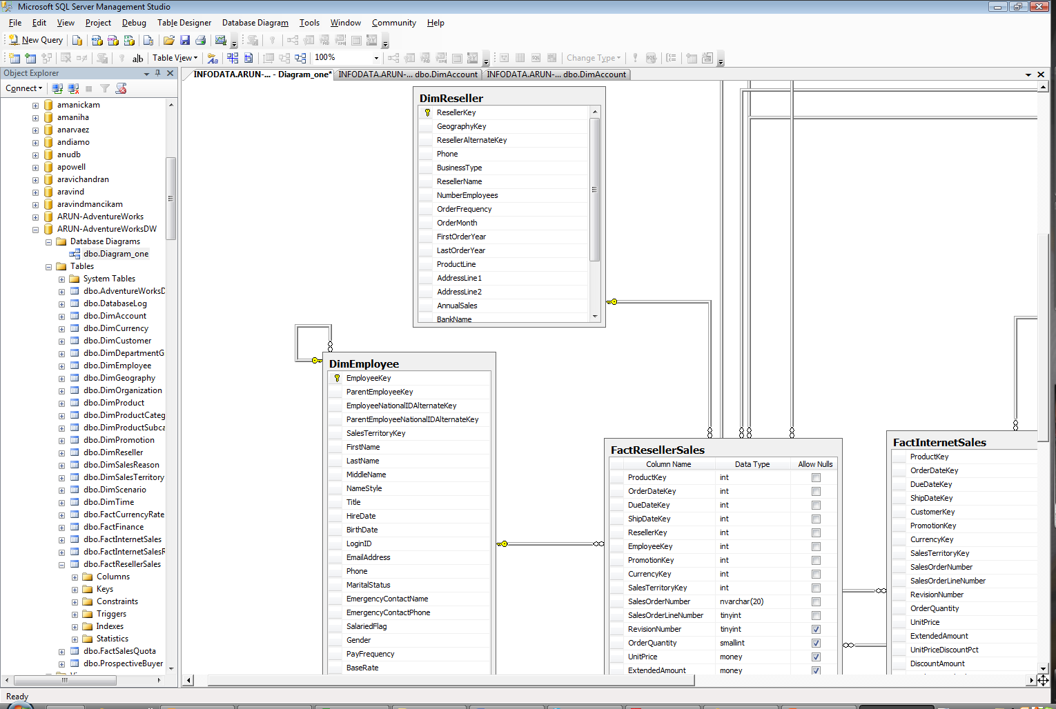
Star Schema
http://www.youtube.com/watch?v=A-G5UVohwQQ

Slide 77
II. Dimensional Modeling and Star/Snowflake Schema
Fact Table

Slide 78
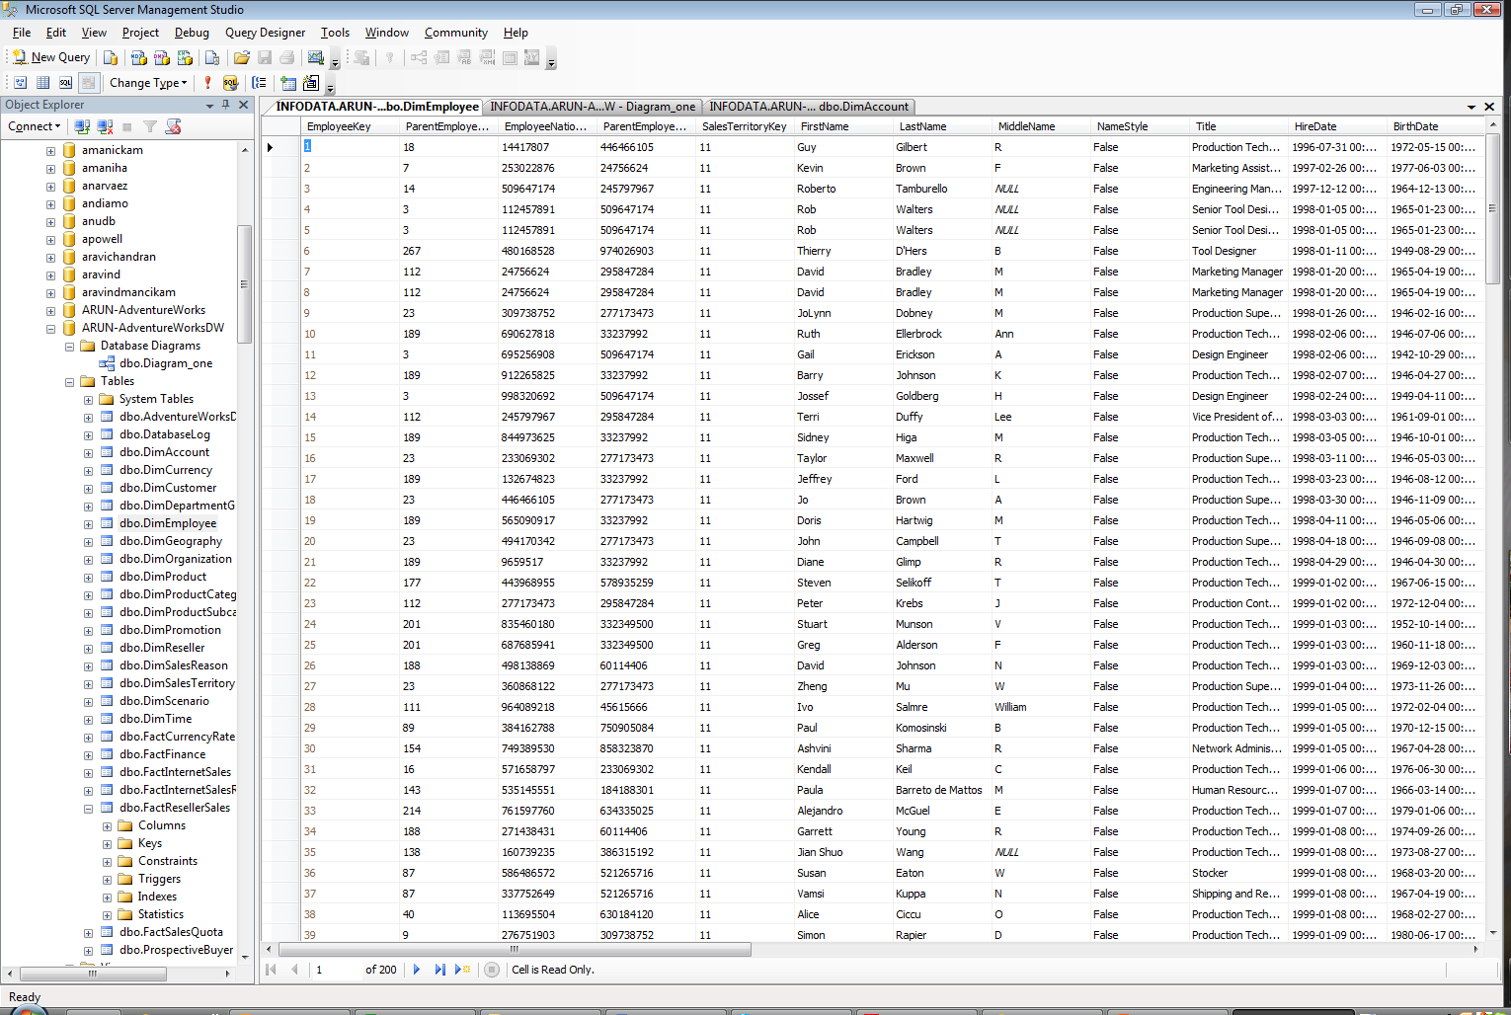
II. Dimensional Modeling and Star/Snowflake Schema
dimEmployee Table

Slide 79
Snowflake Schema
Time Dimension
Sales Fact Table
Time-key (PK)
Day-of-week
week-number
Month
Time-key (FK)
Product-key (FK)
Store-key (FK)
dollars-sold
units-sold
dollars-cost
Product Dim
Product-key (PK)
SKU
description
marketing-brand-key
Store Dimension
Store-key (PK)
store-ID
store-name
address
Marketing-brand-key
marketing brand

Slide 80
Snowflake Schema
12. Permissible Snowflaking
A dimension is said to be “snowflaked” when the low cardinality fields in the dimension have been removed to separate tables and linked back into the original table with artificial key. This helps if the user is asking only for the distinct values of the category….
Snowflaking makes most forms of browsing among the dimension attributes slower.
Not always a good idea because --
creates confusion with the users’ understanding
create problems with “bit mapped indexes”
more administration cost
(Low-cardinality refers to columns with few unique values. Low-cardinality column values are typically status flags, Boolean values, or major classifications such as gender. An example of a data table column with low-cardinality would be a CUSTOMER table with a column named NEW_CUSTOMER. This column would contain only 2 distinct values: Y or N, denoting whether the customer was new or not. Since there are only 2 possible values held in this column, its cardinality type would be referred to as low-cardinality. – Wikipedia)

Slide 81
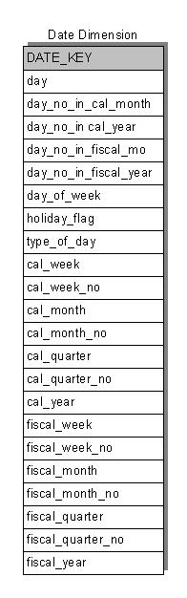
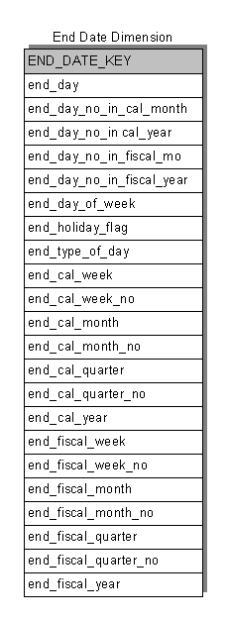
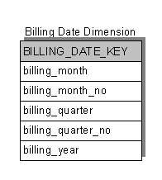
Examples from a TELCO Case Study (Kimball)
Dimension Tables

Slide 82
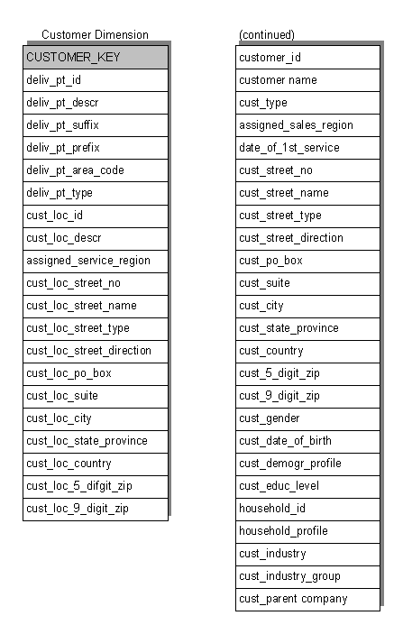
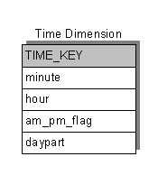
A TELCO Case Study (Kimball)
Dimension Tables

Slide 83
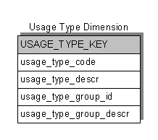
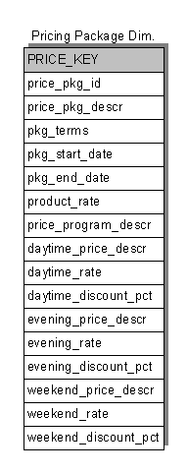
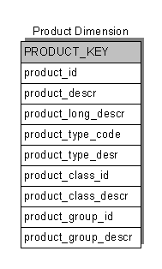
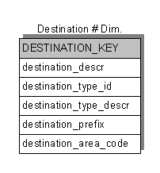
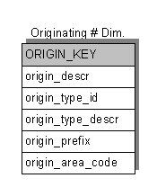
A TELCO Case Study (Kimball)
Dimension Tables

Slide 84
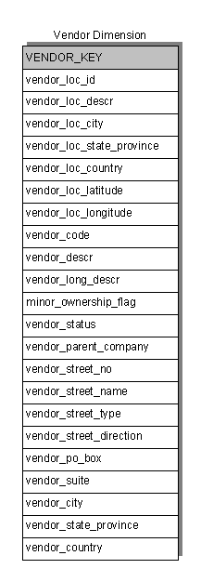
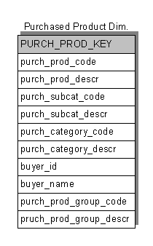
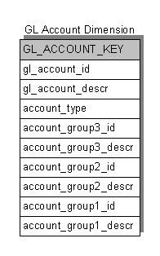
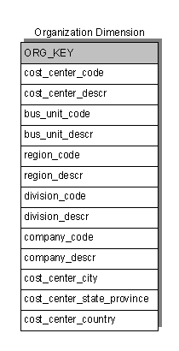
A TELCO Case Study (Kimball)
Dimension Tables

Slide 85
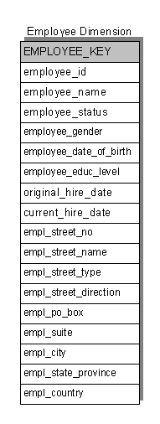
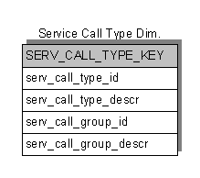
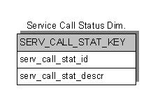
A TELCO Case Study (Kimball)
Dimension Tables

Slide 86
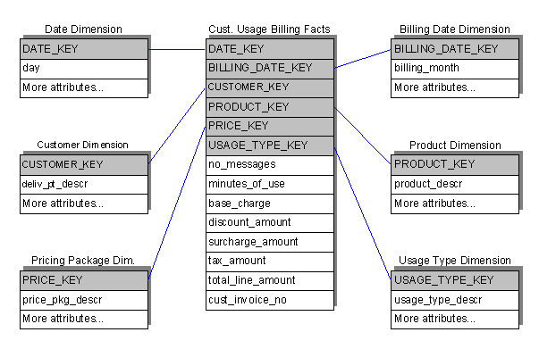
A TELCO Case Study (Kimball)
Star Schema Customer Usage Billing

Slide 87
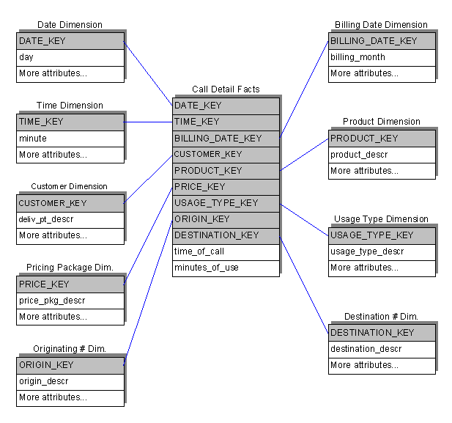
A TELCO Case Study (Kimball)
Star Schema Call Detail Tracking

Slide 88
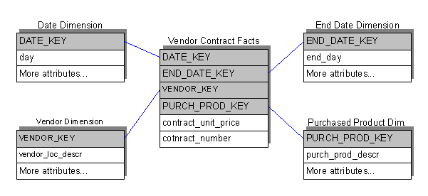
A TELCO Case Study (Kimball)
Star Schema Vendor Contract

Slide 89
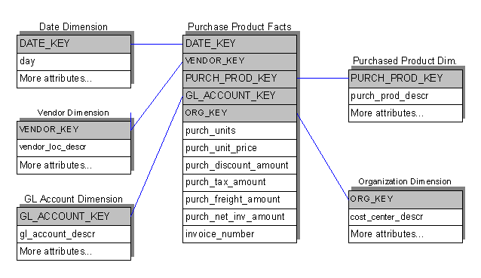
A TELCO Case Study (Kimball)
Star Schema Purchased Product Tracking

Slide 90
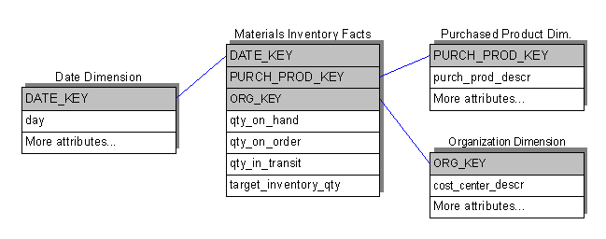
A TELCO Case Study (Kimball)
Star Schema Materials Inventory

Slide 91
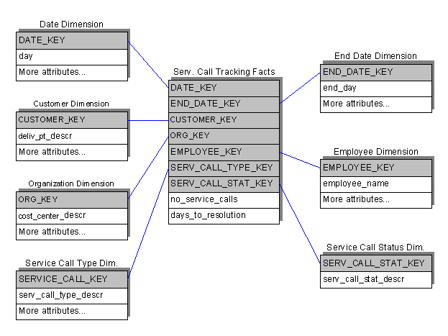
A TELCO Case Study (Kimball)
Star Schema Service Call Tracking

Slide 92
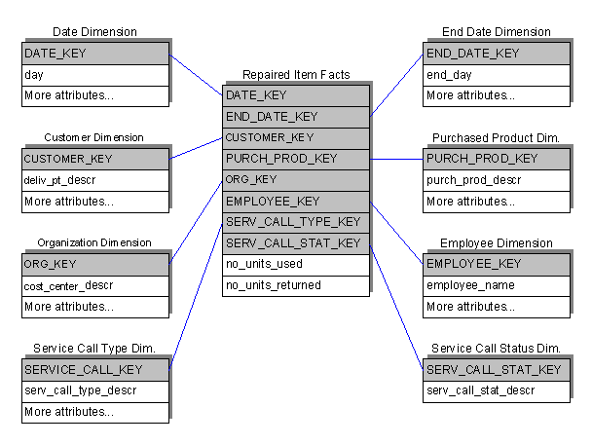
A TELCO Case Study (Kimball)
Star Schema Repaired Items

